Slide 1

PA 604
MEASUREMENT
Professor Burrel Vann Jr

Slide 2

MEASUREMENT
The type of observation you use to indicate a variable
Notes:
For party affiliation, we could ask what people are registered as, or we can also ask what party they identify with.

Slide 3

MEASUREMENT
HOW WOULD YOU MEASURE?
political party affiliation
age
grade point average
religious affiliation
Notes:
For party affiliation, we could ask what people are registered as, or we can also ask what party they identify with.

Slide 4

HOW WOULD YOU MEASURE?
MEASUREMENT
prejudice
compassion

Slide 5

MEASURING THE SOCIAL WORLD WITH CONSTRUCTS
CONSTRUCTS
Theoretical variables, not observed directly or indirectly but having agreed upon meanings (e.g. intelligence)
Have no intrinsic reality, only the meaning we agree to give it
Notes:
Three things
Everyone has different mental images of concepts/constructs. Such that, if I had a paper of a list of all the things I make up prejudice, it might be different from yours. These mental images of constructs/concepts are our subjective interpretations/conceptions of that construct/concept.
Conceptions are our subjective mental images of of constructs

Slide 6

CLEAR
CONSTRUCT
AGE
RACE/ETHNICITY
HEIGHT
RELIGIOUS AFFILIATION
RACISM
THREAT
FEAR
SATISFACTION

Slide 7

OPERATIONALIZATION
Defining how a variable (construct or clear) will be measured

Slide 8

CONSTRUCT
Theoretical, difficult to measure
Racism
OPERATIONALIZING CONSTRUCTS
DIMENSION
a particular aspect of a construct
Institutional Racism
INDICATOR
A direct observation we choose to reflect (a dimension of) a construct
Job rejection
Loan denial
Segregated housing
Notes:
Multiple indicators can make up a single dimension (amongst multiple dimensions) of a concept/variable
Constructs can be broken/divided into several dimensions.
If several indicators accurately represent the same concept, all of them should reach the same result.
Can use different subsets of indicators to accurately measure the concept

Slide 9
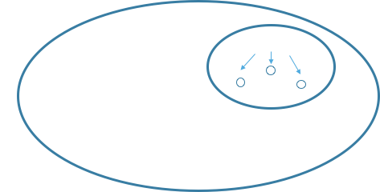
OPERATIONALIZING CONSTRUCTS
Notes:
Variable/concept <- dimension <- indicator
Indicator of religiosity could be “# of religious services attended in last week”
Dimension of religiosity could be “ritual” “activism” “belief” or “devotion”
Concepts can be broken/divided into several dimensions.

Slide 10
OPERATIONALIZING CONSTRUCTS
Defining how a variable (construct or clear) will be measured...
"In this study of Black individuals, I focus on the experience with racism. The first variable, racism, centers specifically on institutional racism. I measure institutional racism using 3 indicators: whether the black individuals in my sample were 1) denied a job, 2) denied a loan, and 3) currently living in segregated housing. All of these measures were coded as either 'Yes' or 'No'."
Notes:
Say you want to look at income: do you constrict your categories or do you try to create categories for everyone to fit in? Do you need to go in 10k increments all the way to above 1million per year or can you simply say 250k or more? Same for lower ranges (is 0 really a good income, or can you say below 5k?). Think about the normal curve, only very few people will fall at the extremes, so clumping/clustering wont hurt your results much.
Important to understand range of variation because for some concepts, such as opinion on nuclear energy, you can’t just create a attitudinal scale ranging from ``do not favor at all’’ to ``favor very much’’ since some people are more than not favoring… they actively oppose it. So think about your research question and the concepts involved and whether or not its wise to include all possible measurements.
If we want to report/describe the unemployment rate in a city, “being unemployed” is critical…
definition of the labor force… since it’s probably not wise to include babies as unemployed.
Also, we may want to use the census version of 14 or above as labor force… and of those,
people who have not been looking for work for a week or more are unemployed.
Unemployment rate
Who is employed?
Who is in the labor force?
What do other definitions include?

Slide 11

CLASSIFYING PARTICIPANT RESPONSES
MUST BE EXHAUSTIVE & MUTUALLY EXCLUSIVE
EXAUSTIVE
Must include options for all possible attributes of a variable to correctly classify all participants.
MUTUALLY EXCLUSIVE
With a few exceptions, each participant should only be able to select/be classified as ONE attribute for each variable
Notes:
Exhaustive:
For party affiliation, you need to list out all possible party affiliations so that each respondent has the opportunity to select their party
Mutually Exclusive:
(race/ethnicity, which should be a checkbox/select all that apply)
(e.g. they are EITHER employed or unemployed, not both).
----
How can we operationally define ____ (both exhaustive and mutually exclusive)?
Party Affiliation

Slide 12

Levels of Measurement
NOMINAL
least sophisticated
ORDINAL
more sophisticated
INTERVAL-RATIO
most sophisticated

Slide 13

LEVELS OF MEASUREMENT
NOMINAL
ORDINAL
INTERVAL-RATIO
Attributes have only the characteristics of exhaustiveness and mutually exclusiveness. Simple categories.
Attributes that classify, but cannot be ranked
religious affiliation, college major, hair color, birthplace, nationality
Attributes that classify and can be logically rank-ordered but lack an associated numerical value
socioeconomic status, level of conflict, prejudice, conservativeness
Distance between attributes has meaning.
Attributes classify, can be rank-ordered, and have an equal numerical distance between values
temperature (Fahrenheit), IQ score
Notes:
Variables whose attributes meet the requirements of a interval measure, and has a true zero point.
Examples: temperature (Kelvin), age, length of time, number of organizations, number of groups, number of A’s received in college

Slide 14
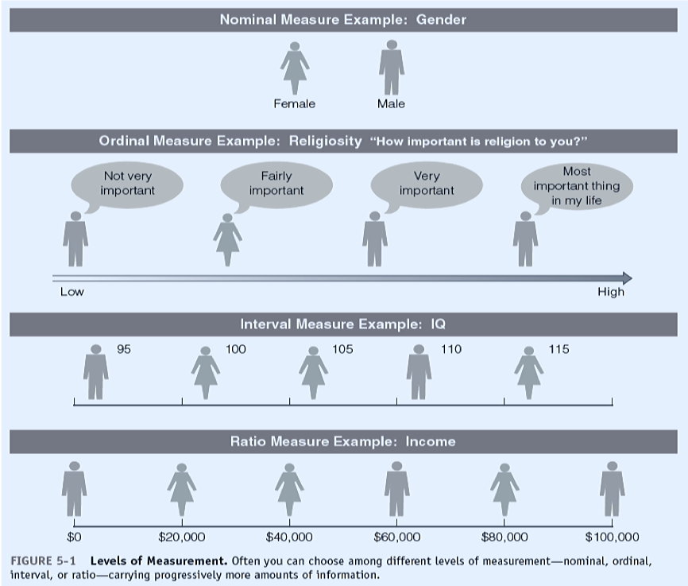
LEVELS OF MEASUREMENT

Slide 15

TEST-RETEST
making the same measurement more than once
ENSURING RELIABILITY
SPLIT-HALF
multiple sets of randomly assigned variables should produce the same classifications
SAME OBSERVATIONS WOULD OCCUR WITH REPEATED MEASUREMENTS OF THE SAME PHENOMENON
ESTABLISHED MEASURES
using measures that have proven reliable in other research
INTER-RATER RELIABILITY
testing how close research workers are in their coding of the data
Notes:
Split half, if there are 10 items that we think correctly classify compassion, we randomly assign 5 to the midterm, and 5 to the final… if they are both reliable measures, both sets of items should classify people in the same way.
Established measures means using items that have shown reliable measurements in the past (MMPI min multiphasic personality inventory, SATs)
Reliability of workers means interrater-reliability, getting multiple trained researchers to code the same data, and see if they classify the data in the same way.

Slide 16
FACE VALIDITY
measurement that seems to make reasonable sense
ENSURING VALIDITY
CRITERION-RELATED
measurement related to some external criterion/outcome (e.g. written DMV test and clean driving records)
CONSTRUCT
MEASUREMENTS THAT ACCURATELY REFLECT THE THING IT IS INTENDED TO MEASURE
degree to which a measure relates to other variables as expected within a system of theoretical relationships (e.g. marital satisfaction related to marital fidelity)
CONTENT
measure that covers the range of meanings included within a concept (e.g. math ability covers +/- , algebra, precal, calc)
Notes:
Face validity: it makes sense, e.g. IQ seems like a way to measure intelligence rather than using than time spent at library… or the number of grievances has something to do with morale in an occupation, although we may disagree if it’s the BEST measure.
Criterion related validity: it has been shown to relate to some outcome (college board exams are good measures of college success, success on a written DMV test is a good predictor of clean driving records).
Construct: Marital satisfaction variables should relate to other variables, such as marital fidelity (more satisfied couples should be less likely to cheat). Since that makes sense theoretically.
Content: should cover the range of the concept/variable (math ability measurements should measure more than just ability on addition or subtraction but a whole swath of math abilities).

Slide 17
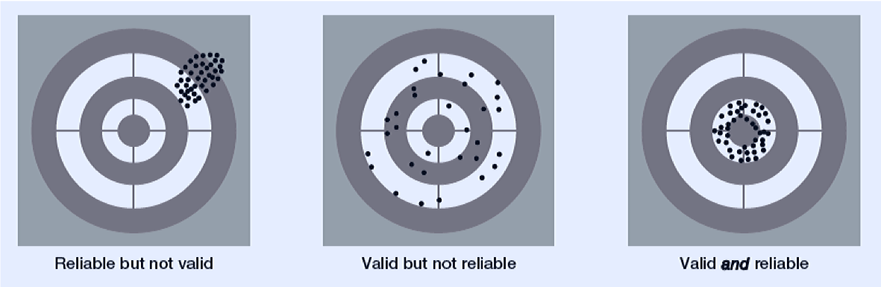
NO VALIDITY WITHOUT RELIABILITY

